Slide 1
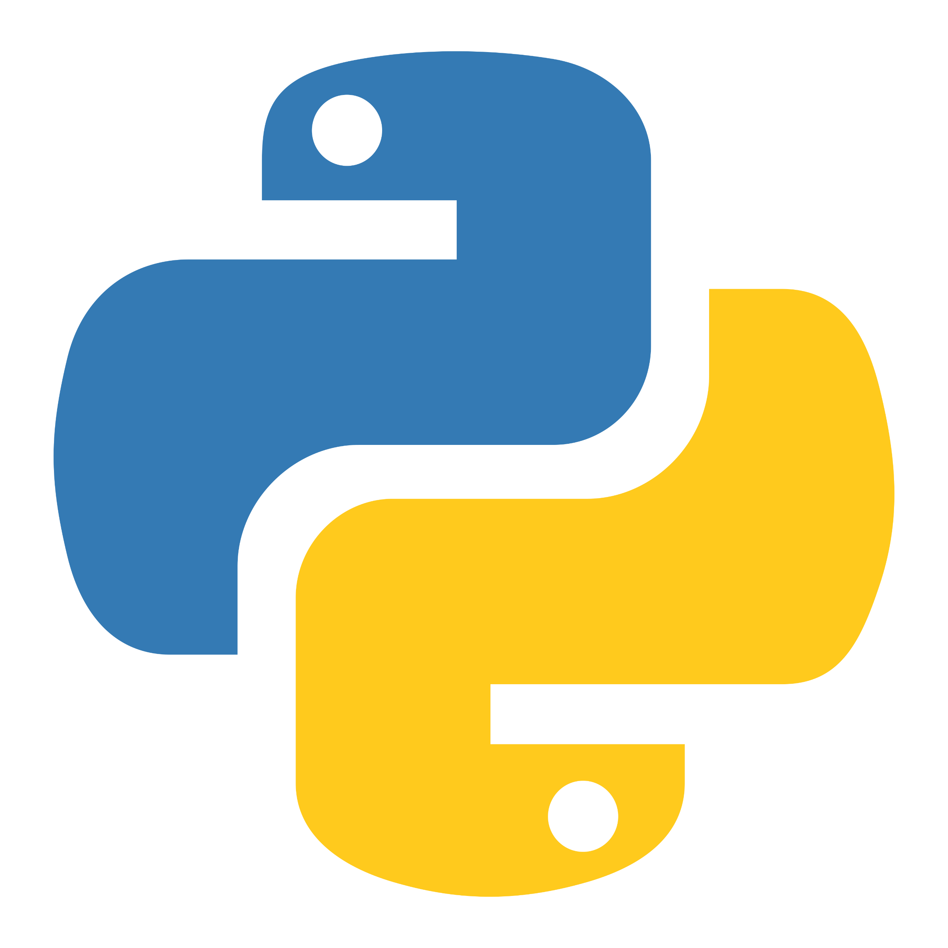
파이썬 설치
2025 Primitive
24 장준성

Slide 2
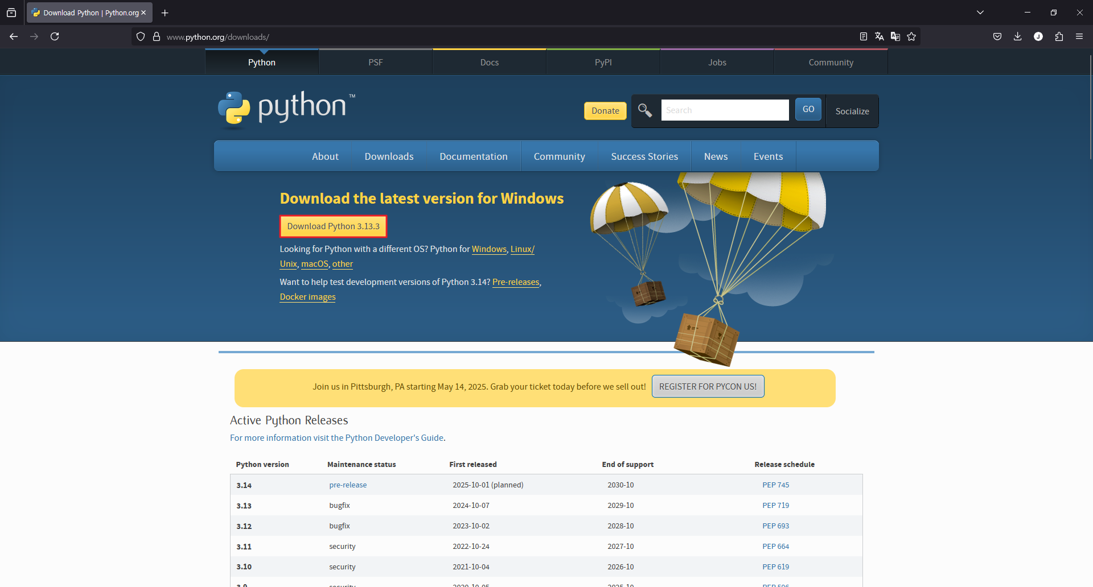
Install Python
https://www.python.org/downloads 접근 후 Download Python 3.13.3 클릭

Slide 3

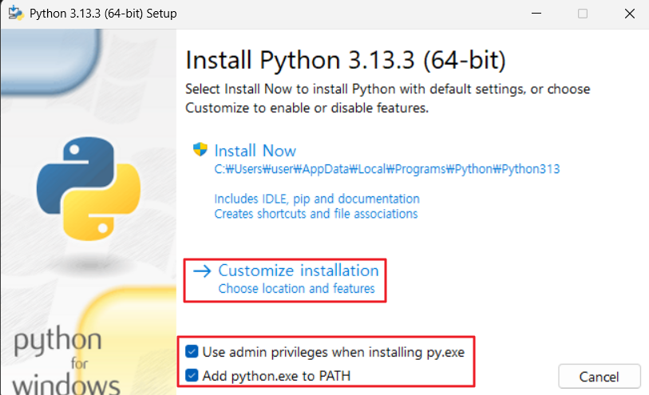
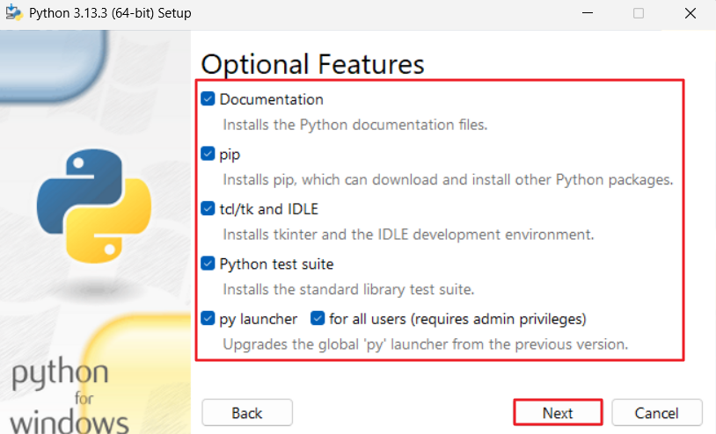
Install Python
python-3.13.3-amd64.exe 실행

Slide 4
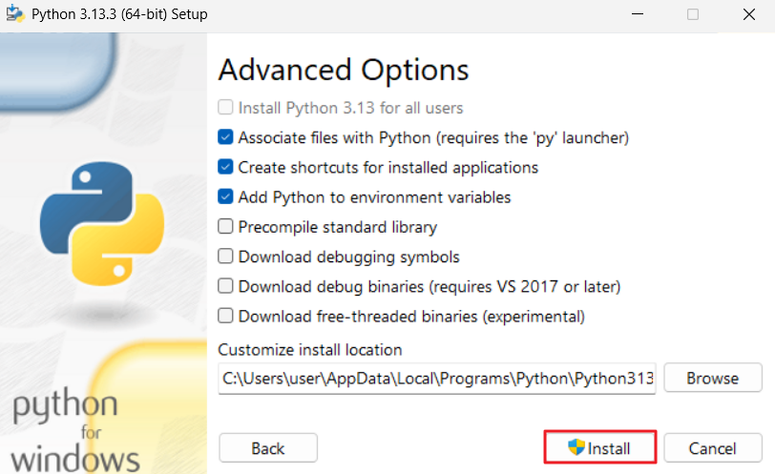
Install Python

Slide 5
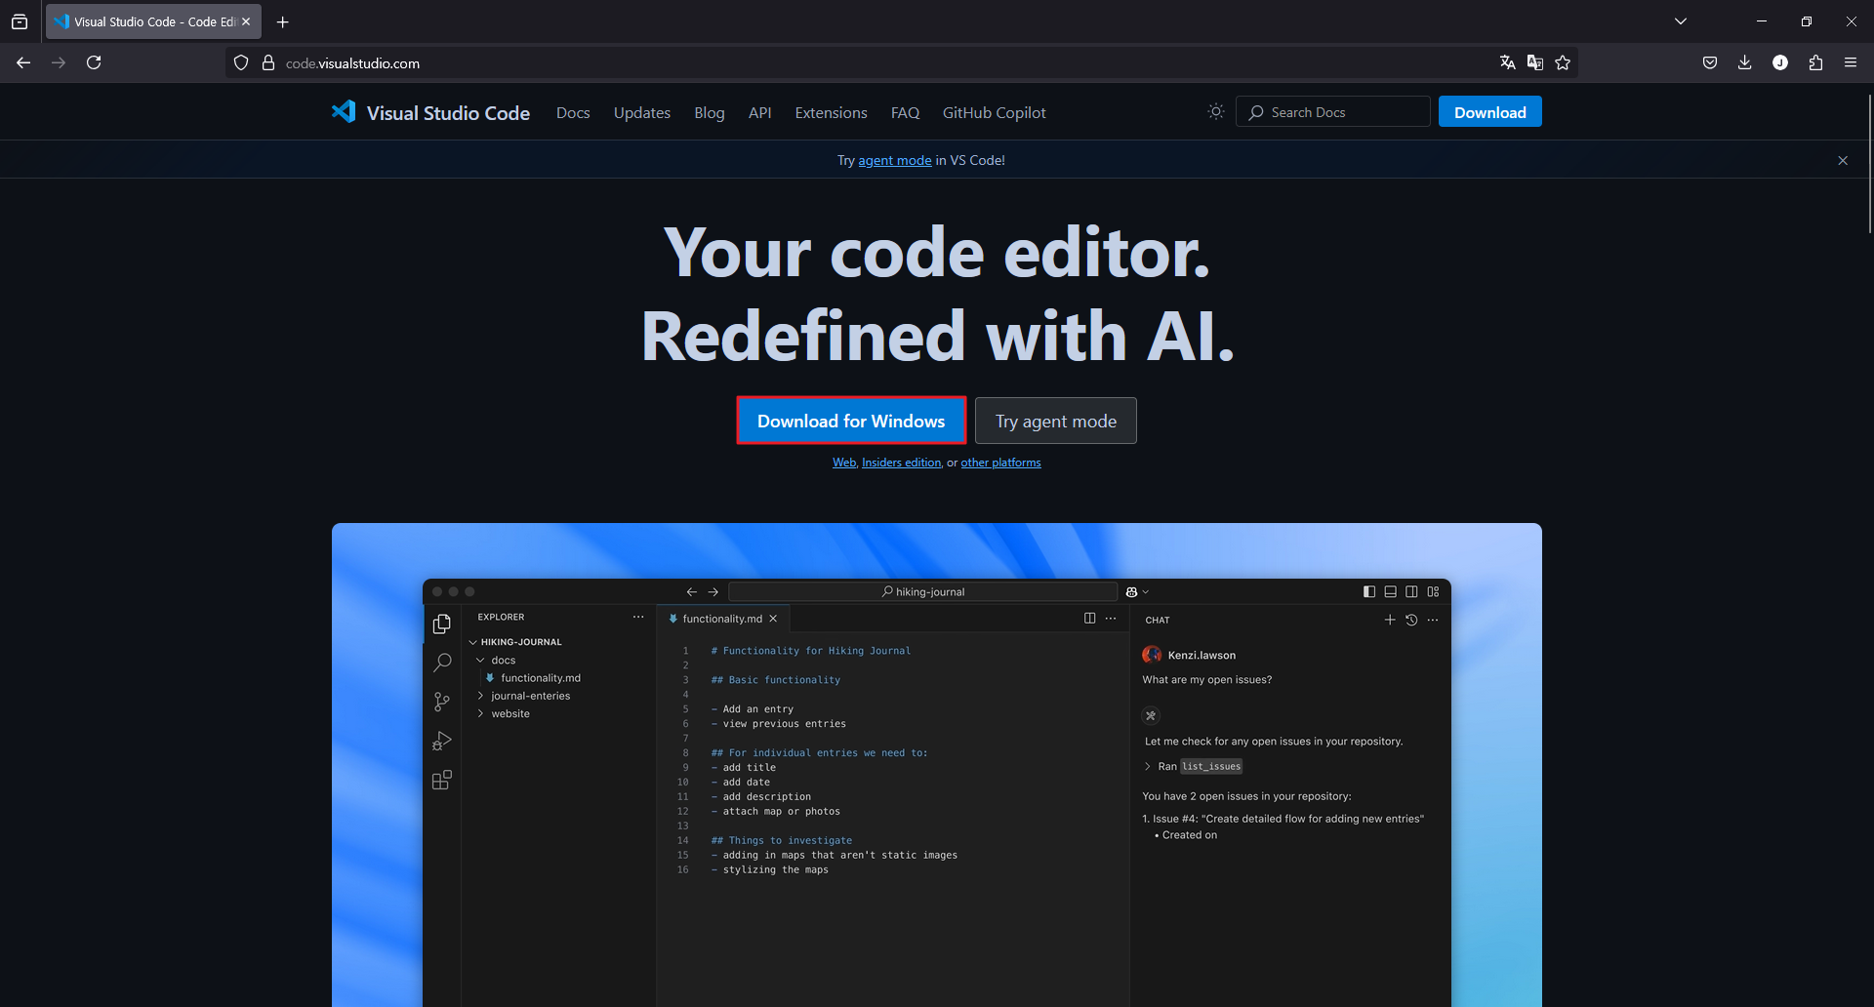
Install Visual Studio Code
https://code.visualstudio.com 접근 후 Download for Windows 클릭

Slide 6

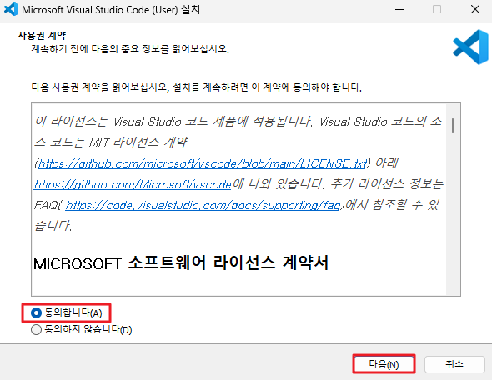
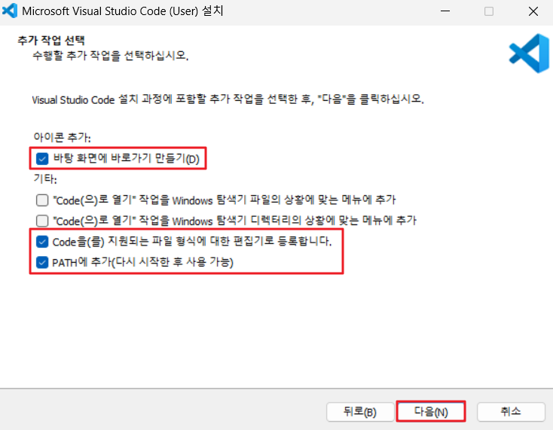
Install Visual Studio Code
VSCodeUserSetup-x65-1.99.3.exe 실행

Slide 7
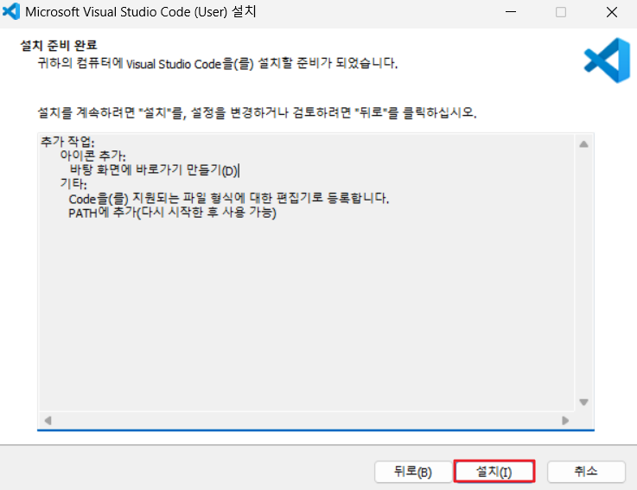
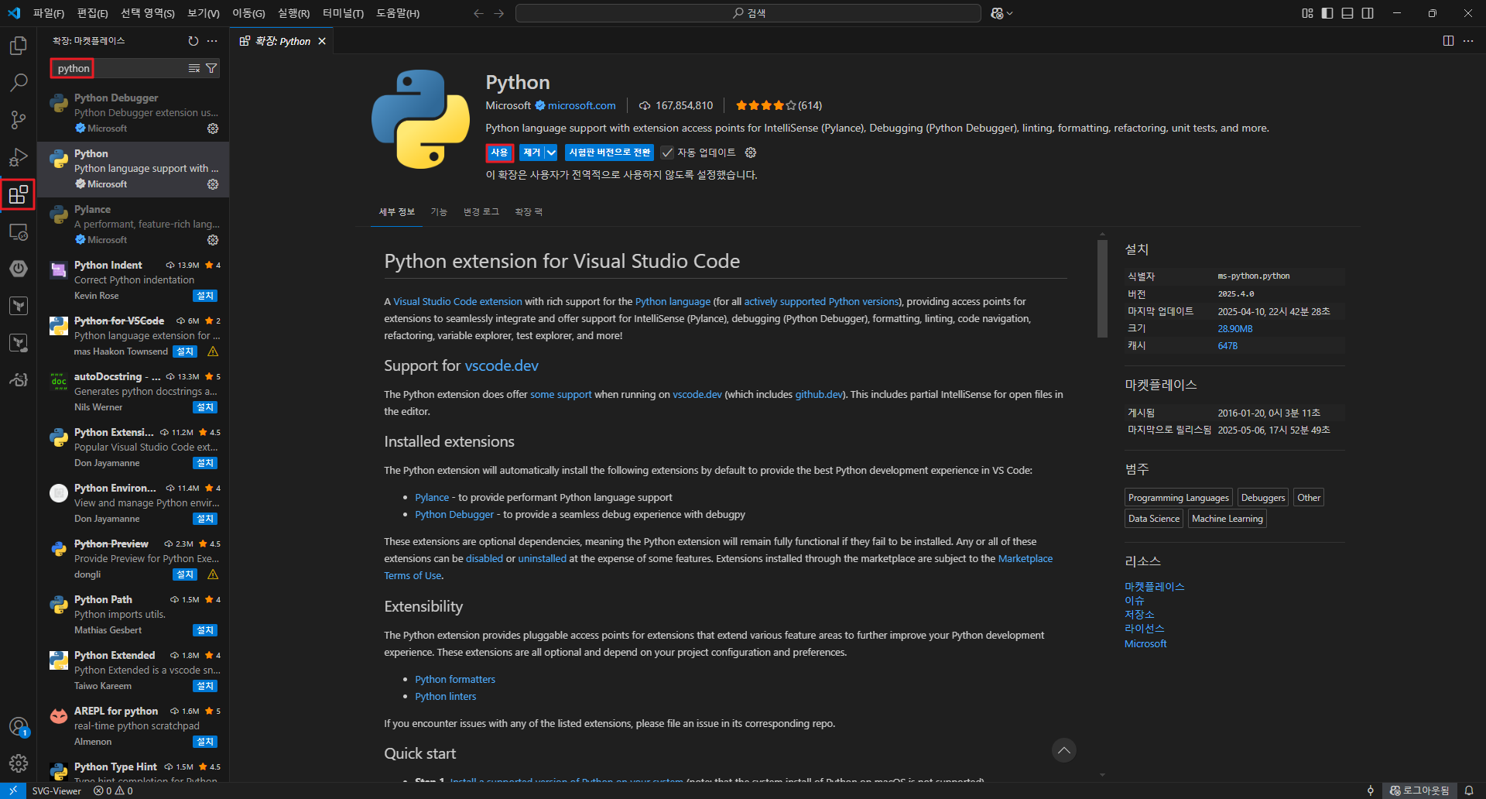
Install Visual Studio Code

